Slide 1
Predicting Plant Health with Neural Networks
Casey Nosiglia
BrainStation Data Science July 2022
Capstone Project
Notes:
· Hello, my name is Casey Nosiglia and today I’ll be presenting a brief summary of my project, “Predicting Plant Health using Neural Networks”, which I completed as part of the BrainStation Data Science boot camp which I participated in this past summer.

Slide 2
Problem
Business Questions
Data Sourcing & Manipulation
Modeling and Findings
Future Directions
Notes:
· First I’ll provide the problem motivation for the project, then present the main business questions to be answered, then discuss the data sourcing and manipulation I conducted, the results of the machine learning modelling and the findings thereof, and finally mention some possible future directions.

Slide 3
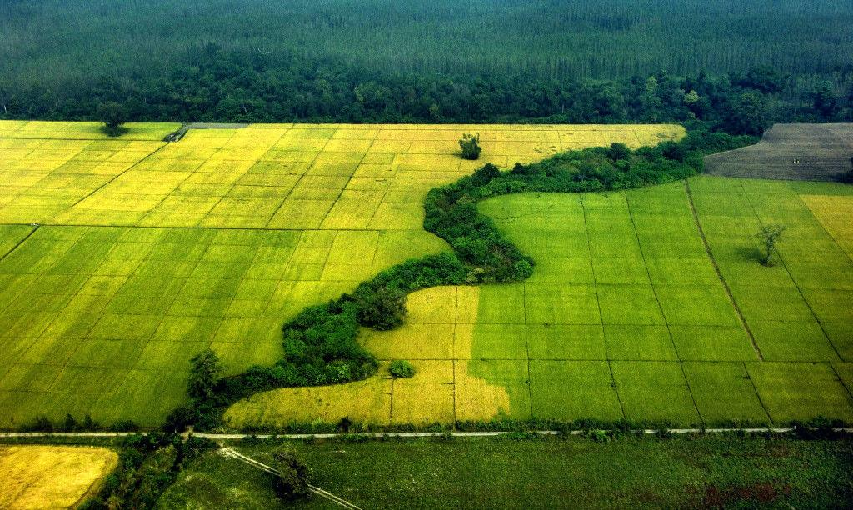
The Problem: Crop Contamination for Smallholders
Loss in crop yield due to pest and pathogen (P & P) contamination commonly ranges from 17% - 30% for common crops (e.g., wheat, rice, maize, potato, soybean).
Notes:
· The agriculture industry is highly dependent on crop health, which may be affected by pests and pathogens; in particular, loss in crop yield from P&P contamination ranges from 17-30% for common crops

Slide 4
The Problem: Crop Contamination for Smallholders
Loss in crop yield due to pest and pathogen (P & P) contamination commonly ranges from 17% - 30% for common crops (e.g., wheat, rice, maize, potato, soybean).
Smallholder farms produce 32% of the world’s food; many in developing nations.
Notes:
· While large factory farms may have the resources to identify unfamiliar P&P contamination, smallholder farms (defined as farms under 2 hectares) may not; this is a problem, as smallholder farms produce 32% of the world’s food, with many in developing nations.

Slide 5
The Problem: Crop Contamination for Smallholders
Loss in crop yield due to pest and pathogen (P & P) contamination commonly ranges from 17% - 30% for common crops (e.g., wheat, rice, maize, potato, soybean).
Smallholder farms produce 32% of the world’s food; many in developing nations.
84% of the world’s population have smartphones, with projections to increase -> opportunity for expanding crop disease monitoring.
_____________________________________________________________________________________________________
Sources: https://www.fao.org/news/story/en/item/1395127/icode/, https://www.nature.com/articles/s41559-018-0793-y,
https://www.bankmycell.com/blog/how-many-phones-are-in-the-world
Notes:
· However, due to the rapid growth of smartphone technology, 84% of the world’s population now have smartphone access, creating an opportunity for smallholder farmers to easily identify unfamiliar disease in their own crops using their smartphone cameras.

Slide 6
Business Questions
Can a computer correctly identify healthy/diseased (amongst all species)?
Can a computer correctly identify the disease type within a given species (e.g., tomato)?
Notes:
· Given the potential of empowering smallholder farmers to diagnose their own crops with smartphone technology, I asked the following two business questions: first, can a computer correctly identify images of healthy and diseased leaves among several plant species? And second, can a computer correctly identify the disease type within a given species (such as tomatoes)?

Slide 7
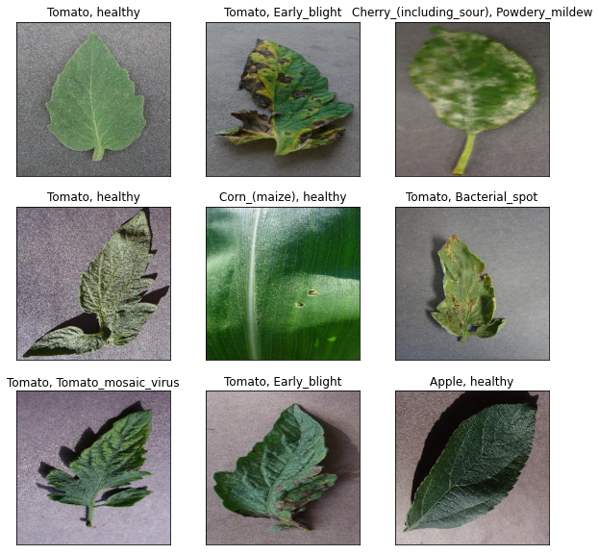
Data Sourcing
Plant Disease Dataset: https://www.kaggle.com/datasets/saroz014/plant-disease
54.3k images with 14 plant species and 26 diseases represented.
Notes:
· In order to answer my business questions, I used the plant disease dataset from Kaggle, which includes highly curated images of plant leaves from the opensource PlantVillage project.
· In this dataset, there are 54.3k plant leaf images, with 14 different plant species and 26 plant diseases represented, with some examples shown on the right.

Slide 8
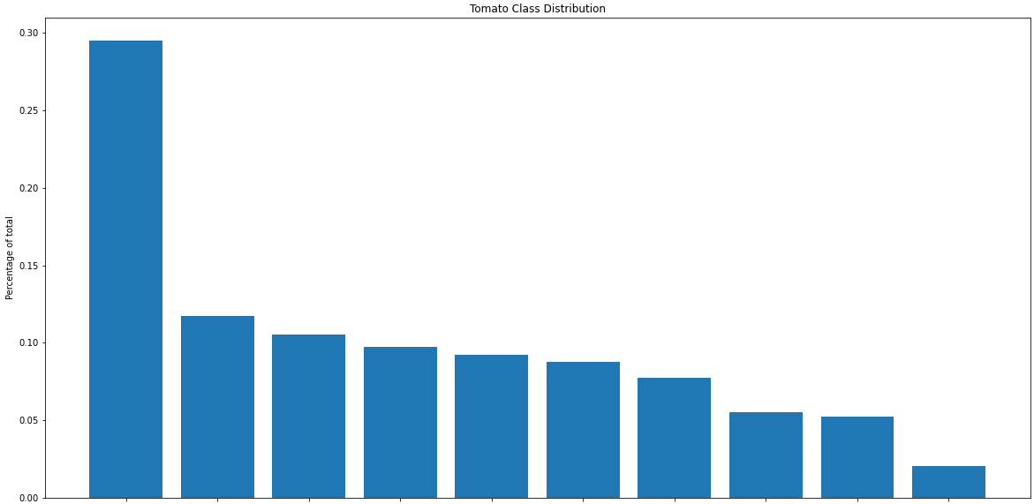
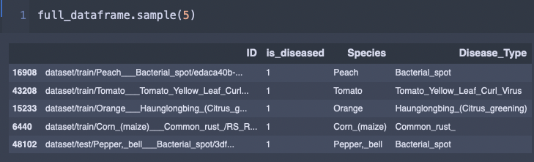
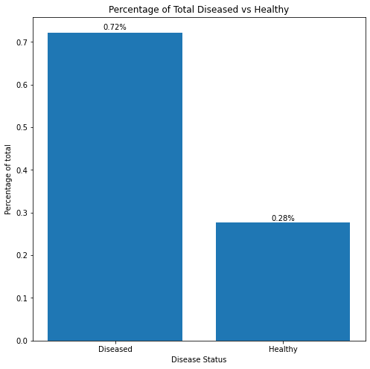
Data Manipulation and EDA
Stored various labels in a dataframe:
54.3k images with 14 plant species and 26 diseases represented.
Dataframe allows for easier manipulation of variables and EDA -> Looked at class distributions.
Notes:
· In order to handle the images, I created a dataframe including relevant information from the image files, such as the original filepath as an ID column, an is_diseased column with a binary outcome, a species column, and a disease-type column.
· Organizing the data in such a manner allowed for easier manipulation of the image files and made exploratory data analysis easier. In particular, I was able to look at the class distributions for the various disease types for tomatoes as shown above, and the disease status (i.e. healthy vs. diseased) among all plant species, as shown below.
· From here I was able to generate curated datasets for my two business questions.

Slide 9
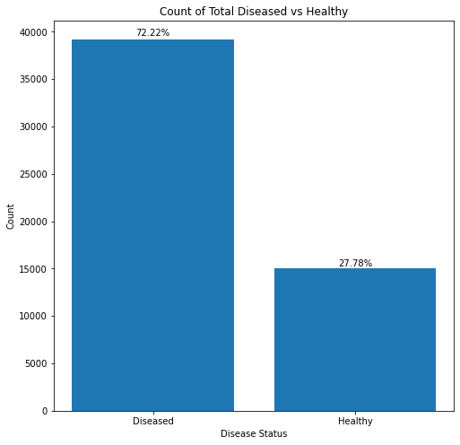
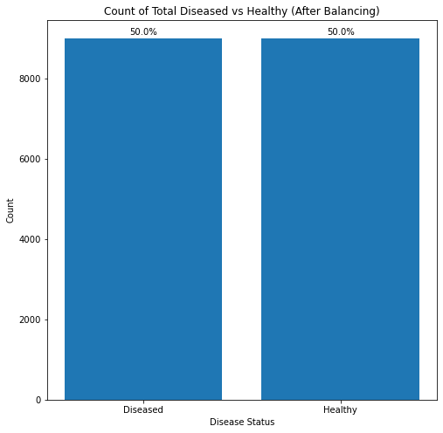
Class Balancing - Diseased vs. Healthy
Notes:
· As part of my data curation, for the diseased vs healthy classification problem, I downsampled each class to 9000 images each, so that the classes would be equally represented, and then put the balanced downsampled labels in a new dataframe.
· I then engineered a train/validation/test split of 56%/24%/20% stratified by species and disease type, for deployment to a machine learning model, as I will describe shortly.

Slide 10
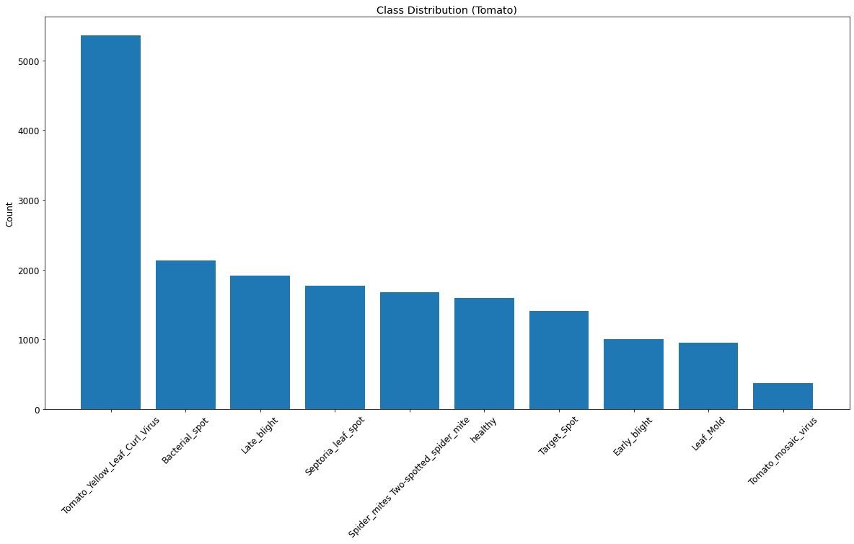
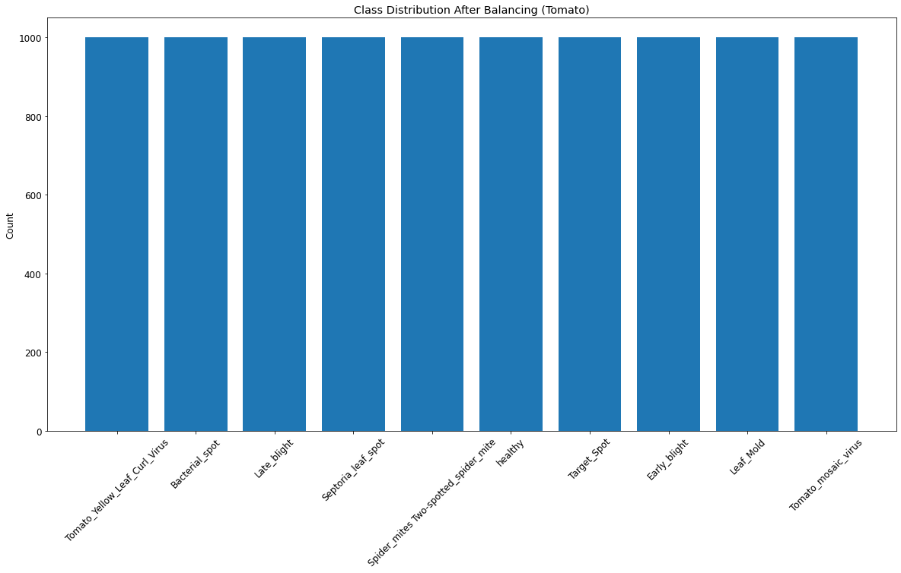
Class Balancing - Tomatoes
Notes:
· Similarly, for the tomato classes (including healthy plus 9 different diseases), I up and downsampled so that each tomato class would have 1000 images each, and then put the balanced tomato classes in a third dataframe, and engineered a train/validation/test split of 56%/24%/20% stratified by species and disease type as before.

Slide 11
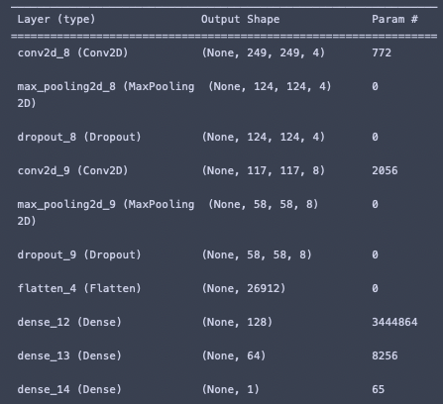
CNN for Diseased/Healthy Problem
Simple CNN architecture
5 epochs, batch = 32
Train acc. = 87.99%
Test acc = 89.77%

Slide 12
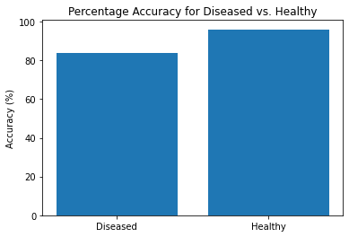
Modeling and Findings: Diseased vs. Healthy
Convolutional Neural Network (CNN) with normalization and data augmentation.
Notes:
· In order to classify diseased vs. healthy, I used convolutional neural networks, and I normalized and augmented my data to minimize overlearning the training data

Slide 13
Modeling and Findings: Diseased vs. Healthy
Convolutional Neural Network (CNN) with normalization and data augmentation.
Overall classification accuracy: 90%
Notes:
· After optimizing my parameters, my best model was able to classify the images correctly 90% of the time, correctly identifying healthy images 96% of the time and correctly identifying diseased images 84% of the time.

Slide 14
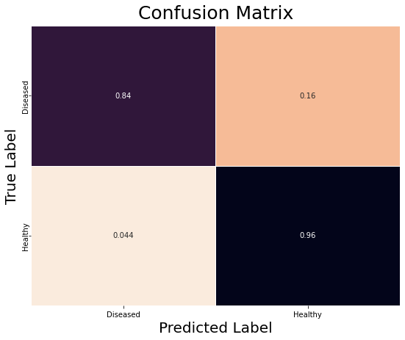
Modeling and Findings: Diseased vs. Healthy
Convolutional Neural Network (CNN) with normalization and data augmentation.
Overall classification accuracy: 90%.
Confusion matrix: healthy label over-applied.
Notes:
· I then created a confusion matrix (which shows the percentages of true positives, false positives, false negatives, and true negatives during image classification), we can see that the healthy label is over-applied (i.e., the healthy label is incorrectly applied to diseased images 16% of the time); this indicates that the model needs to be further optimized to pick up more subtle disease patterns.

Slide 15
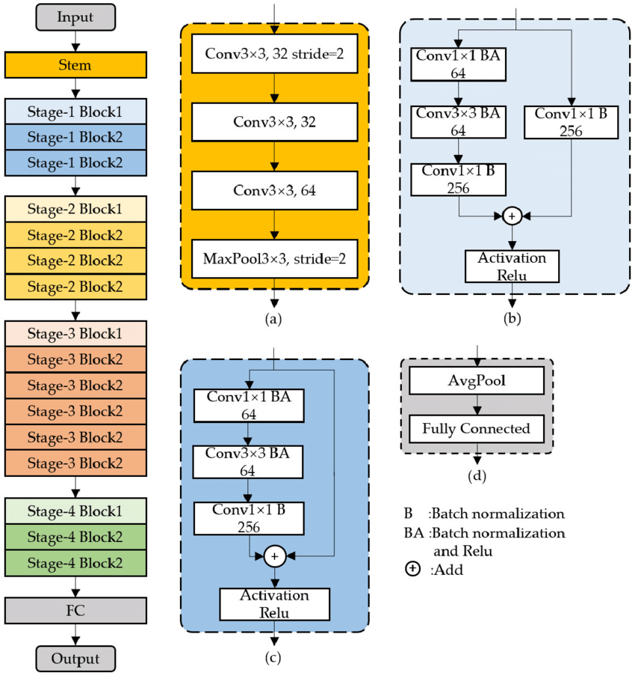
Modeling and Findings: Tomato
Tried several simple CNN architectures; no success.
Switched to ResNet50 w/frozen layers -> allows for more robustness with less computing overhead.
Notes:
· For identifying the 10 different tomato classes (1 healthy and 9 diseases), I first tried several simple CNN architectures without success.
· Then I switched to an advanced CNN architecture called ResNet50, and adapted it to my classification problem. ResNet50 is an architecture used for image recognition, with pre-trained layers which may or may not be frozen and output to further layers for training, which allows for more robustness with less computing overhead. An example of the ResNet50 architecture is shown on the right.

Slide 16
Modeling and Findings: Tomato
Varied data augmentation strategies -> final run (batch = 32, epochs = 6) yielded 91% train acc., 89% test acc.

Slide 17
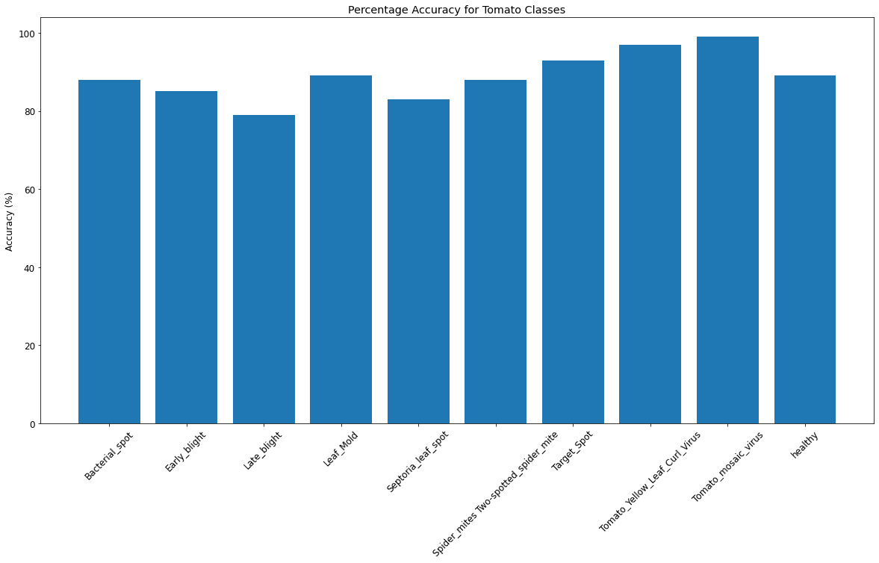
Modeling and Findings: Tomato
ResNet50 with normalization and data augmentation.
Notes:
· As part of employing the ResNet50 model, I used the fully frozen ResNet50 layers with a single output layer to be trained for the 10 different tomato classes, and I normalized and augmented my data to minimize overlearning the training data.

Slide 18
Modeling and Findings: Tomato
ResNet50 with normalization and data augmentation.
Overall classification accuracy: 89%
Notes:
· After optimization, my model was able to classify the images correctly 89% of the time, with the accuracies for each class shown on the right.

Slide 19
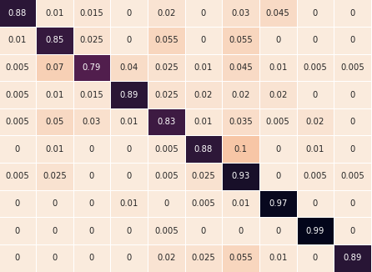
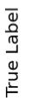
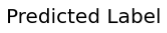
Modeling and Findings: Tomato
ResNet50 with normalization and data augmentation.
Overall classification accuracy: 89%
Confusion matrix:
Notes:
· Furthermore, I computed the confusion matrix for the 10 tomato classes, in order to see how the accuracy varied for each label, and to see where misclassification most frequently occurred.

Slide 20
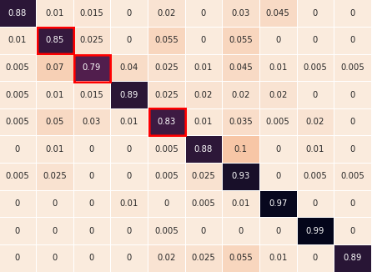
Modeling and Findings: Tomato
Lowest accuracy for:
2: Late blight (79%)
4: Septoria (83%)
1: Early blight (85%).
Notes:
· A first observation is that the model was most inaccurate in identifying late blight at 79%, septoria at 83%, and early blight at 85%, as highlighted in red.

Slide 21
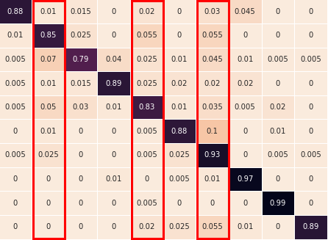
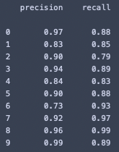
Modeling and Findings: Tomato
Lowest precision:
6: target spot (73%)
1: early blight (83%)
4: septoria (84%)
Notes:
· Digging in further, I calculated precisions and recalls for each class. Precision is a measure of how often a label is applied correctly out of the total number of times it is applied, and is found by taking the diagonal element in a column divided by the sum of the elements in the same column. The lowest three precisions were for the target spot at 73%, the early blight at 83%, and the septoria at 84%, as indicated by the red columns. Heuristically, I observed that these disease patterns tended to be either subtle patterns in the case of target spot, or had a lot of variation in appearance in the case of early blight and septoria, which may have lead to over application of these labels.

Slide 22
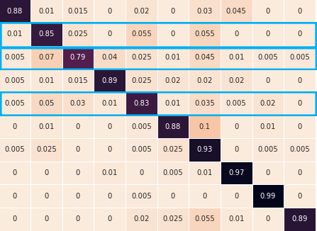
Modeling and Findings: Tomato
Lowest recall:
2: late blight (79%)
4: septoria (83%)
1: early blight (85%)
Notes:
· I also calculated the recalls for each class. Recall is a measure of how often a label is applied correctly out of the total number of cases of that label in the dataset, and is found by taking the diagonal element in a row divided by the sum of the elements in the same row. The lowest three recalls were for the late blight at 79%, septoria at 83%, and the early blight at 85%, as indicated by the blue rows. Heuristically, we observed that all of these disease patterns (late blight, septoria and early blight) all tended to have high variation in appearance, which may have lead to more frequent mislabelling.

Slide 23
Ideas for the Future
Improve accuracy of both models.
Extend to classify all classes (12 healthy + 26 diseased).
Build new model for classification of diseases of new species.
Notes:
· In order to improve this project for the future, I’d like to first improve the classification accuracy of both models, and then try the full classification problem for the 12 healthy and 26 diseased classes, and finally build a new model trained on a broader dataset for classification of a wider variety of diseases.

Slide 24

Thank you! Contact
Special thanks to the Data Science instructors and my fellow classmates!
caseynosiglia@gmail.com
https://www.linkedin.com/in/casey-nosiglia
Notes:
· Thank you for listening, and I want to give a special thanks to the Data Science instructors and my fellow classmates.

